Slide 1
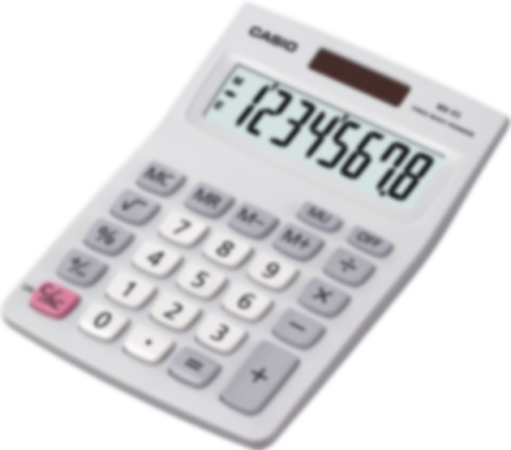

Calculator
Loading … 18%
Weekly demo
Arnold BARNA
2017-09-22

Slide 2
Features
Given a string of operators (+ - * and /) and numbers
Calculation order is of importance:
Multiplication, Division
Addition, Subtraction
“2/2+3*4-6” expected to be 7

Slide 3
Challenges
When parsing:
No String.Split() as there are no spaces “ ” to split by

Slide 4
Challenges
When calculating:
Linear approach doesn’t work “2+2*4+8/2 …”

Slide 5
Solution - Parsing
Parsing into List<string>
“5/2+3*4-5.5” =>
“5”, “/”, “2”, “+”, “3”, “*”, “4”, “-”, “5.5”
List.Count = 9

Slide 6
Solution – Perform Calculation
Collapsing list
Look for multiplications and perform them
“5”, “/”, “2”, “+”, “3”, “*”, “4”, “-”, “5.5”
“5”, “/”, “2”, “+”, “12”, “-”, “5.5”
List.Count = 7

Slide 7
Solution – Perform Calculation
Collapsing list
Look for divisions and perform them
“5”, “/”, “2”, “+”, “12”, “-”, “5.5”
“2.5”, “+”, “12”, “-”, “5.5”
List.Count = 5

Slide 8
Solution – Perform Calculation
Collapsing list
Look for additions and perform them
“2.5”, “+”, “12”, “-”, “5.5”
“14.5”, “-”, “5.5”
List.Count = 3

Slide 9
Solution – Perform Calculation
Collapsing list
Look for subtractions and perform them
“14.5”, “-”, “5.5”
“9”
List.Count = 1

Slide 10
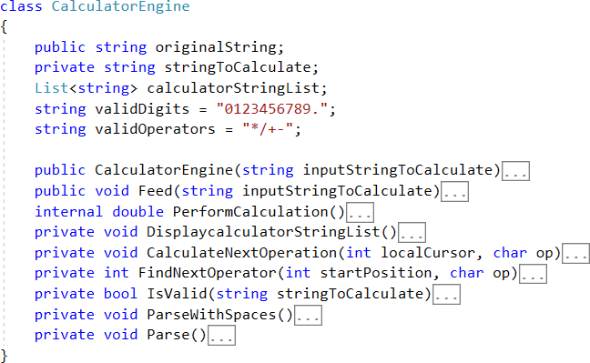
Snippets

Slide 11
Snippets

Slide 12
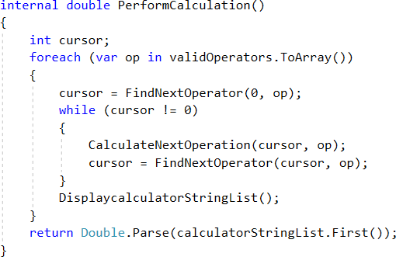
Snippets

Slide 13
Thank you for the attention
Available on GitHub:
Code:
https://github.com/greenfox-academy/bramble100/tree/master/week-03/Calculator
Slides:
https://github.com/greenfox-academy/bramble100/tree/master/week-03/demo

